Slide 1


Thynk Unlimited
@@TO$$
BUSINESS PRESENTATION
Telephone
Address
Website
December 2023
+123-456-7890
123 Anywhere St., Any City,
ST 12345
www.reallygreatsite.com

Slide 2

ABOUT US
GET TO KNOW US BETTER
@@in$$

Slide 3

PROBLEMS
WE WILL SOLVE THE PROBLEMS
01
@@PS1T$$
@@PS1$$
02
@@PS2T$$
@@PS2$$

Slide 4

SOLUTIONS
SOLUTIONS OF THE PROBLEMS
01
@@S1t$$
@@S1$$
02
@@S2t$$
@@S2$$
Thynk Unlimited

Slide 5

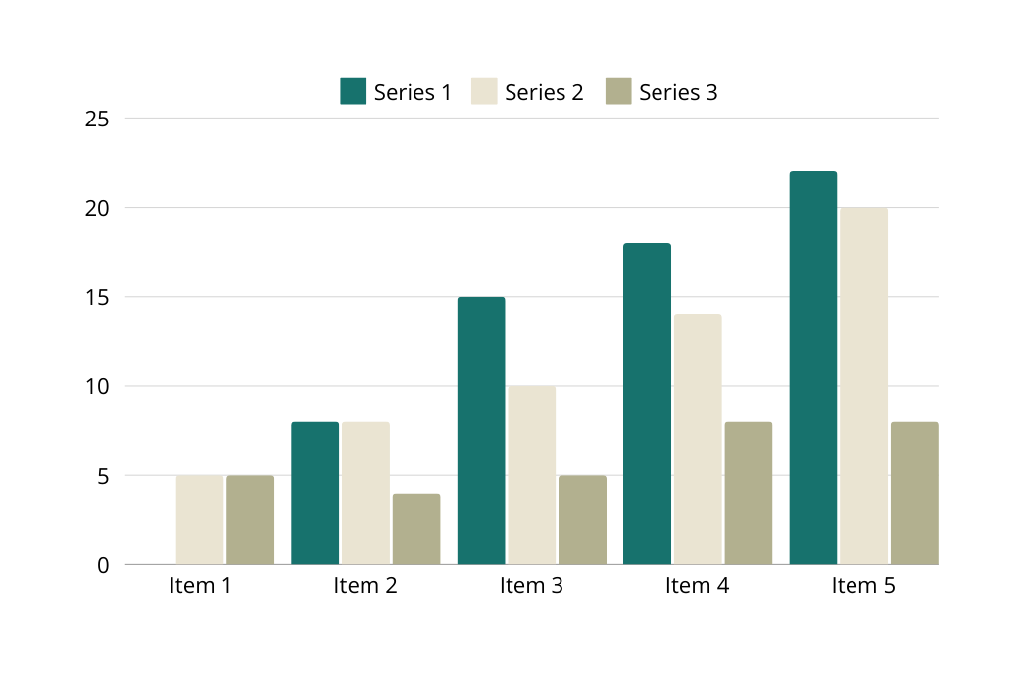
BUSINESS MODEL
OUR BUSINESS MODEL
@@B1$$

Slide 6

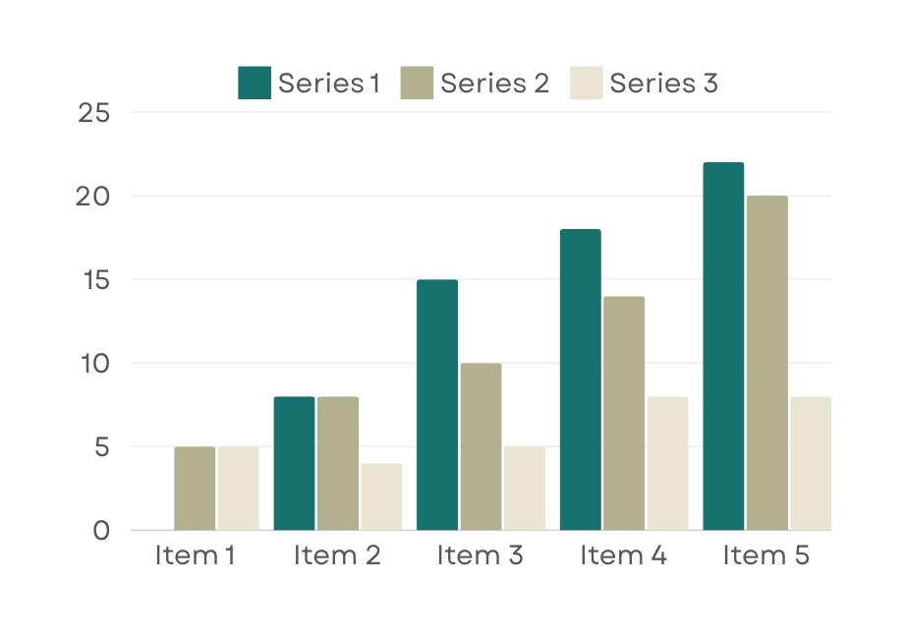
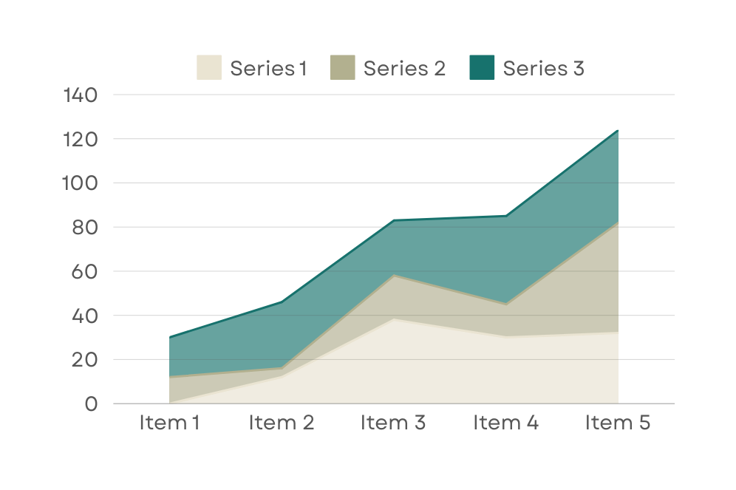
STATISTIC
Thynk Unlimited
Our Customer’s Satisfaction
Repeat Order Rate
An impressive client satisfaction rate underscores our unwavering commitment to delivering exceptional service and exceeding expectations.
Our remarkable client repeat order rate of 123 times are testament to the quality of our products/services and the trust our clients place in our ability.

Slide 7
MARKET OPPURTUNITY
@@MO1t$$
@@MO2t$$
@@MO1$$
@@MO2$$

Slide 8
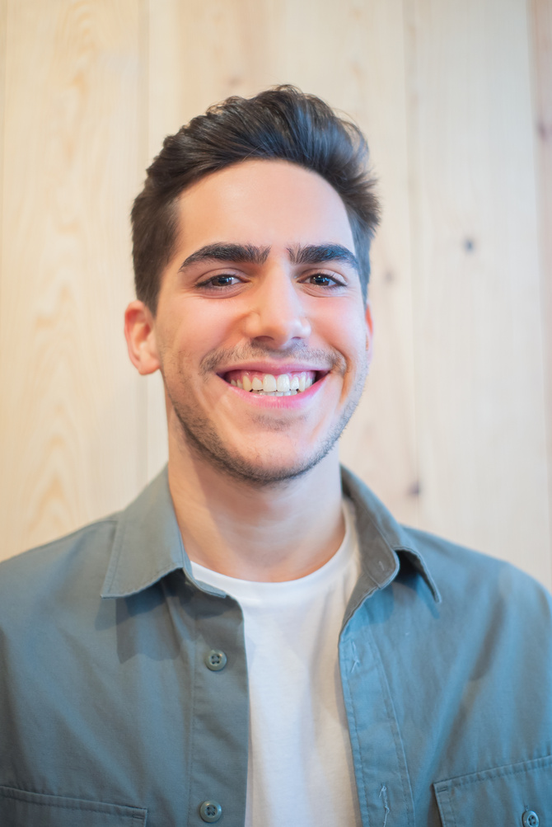
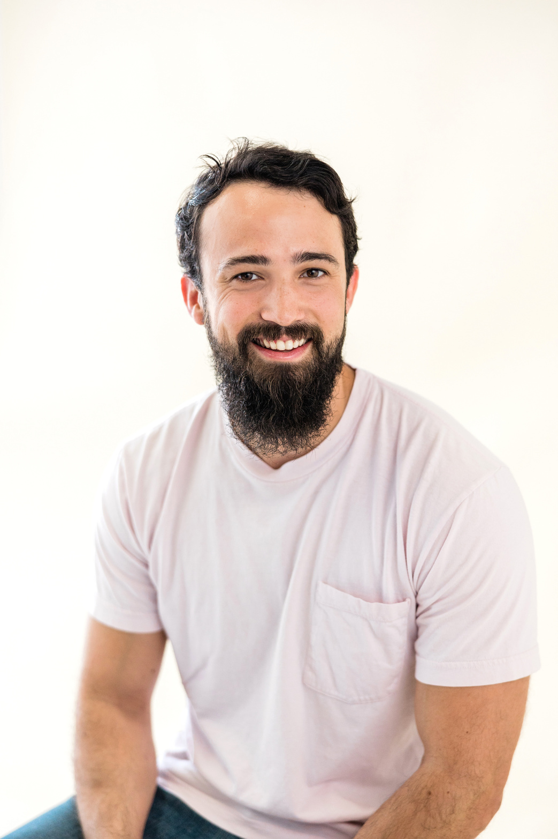
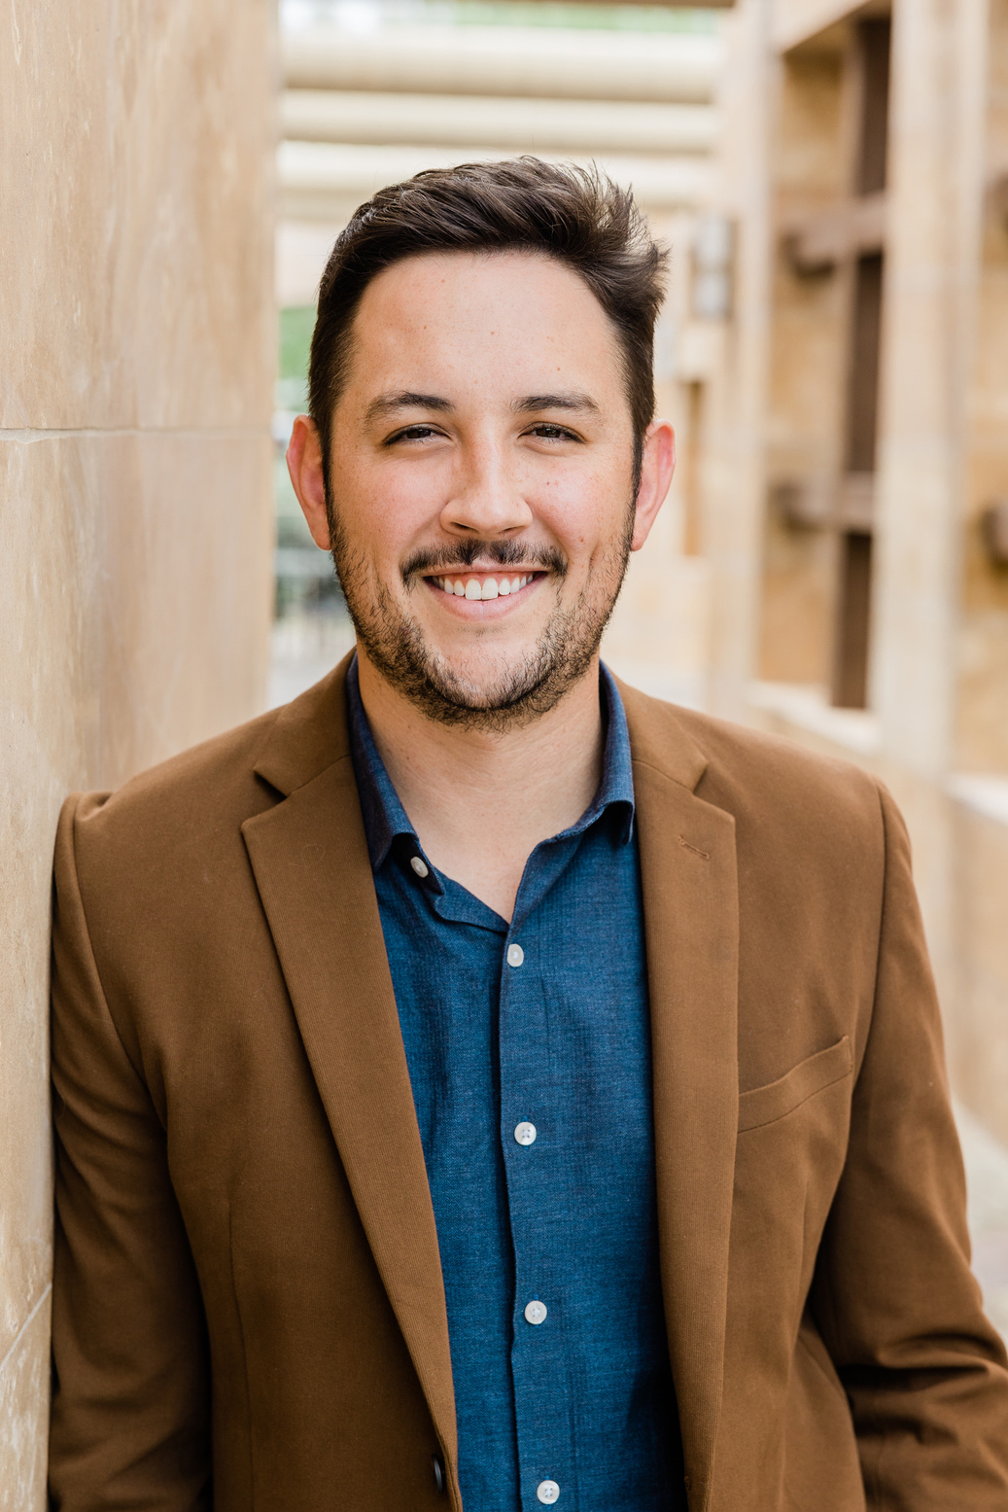
TEAM
Thynk Unlimited
@@T1$$
@@T2$$
@@T3$$

Slide 9
Thynk Unlimited
THANK YOU
FOR YOUR NICE ATTENTION
Address
Mail
December 2023
@@AD$$
@@CD$$

